Slide 1
Creating risk profile on electronic patient record
Savitha Mamidiyala

Slide 2
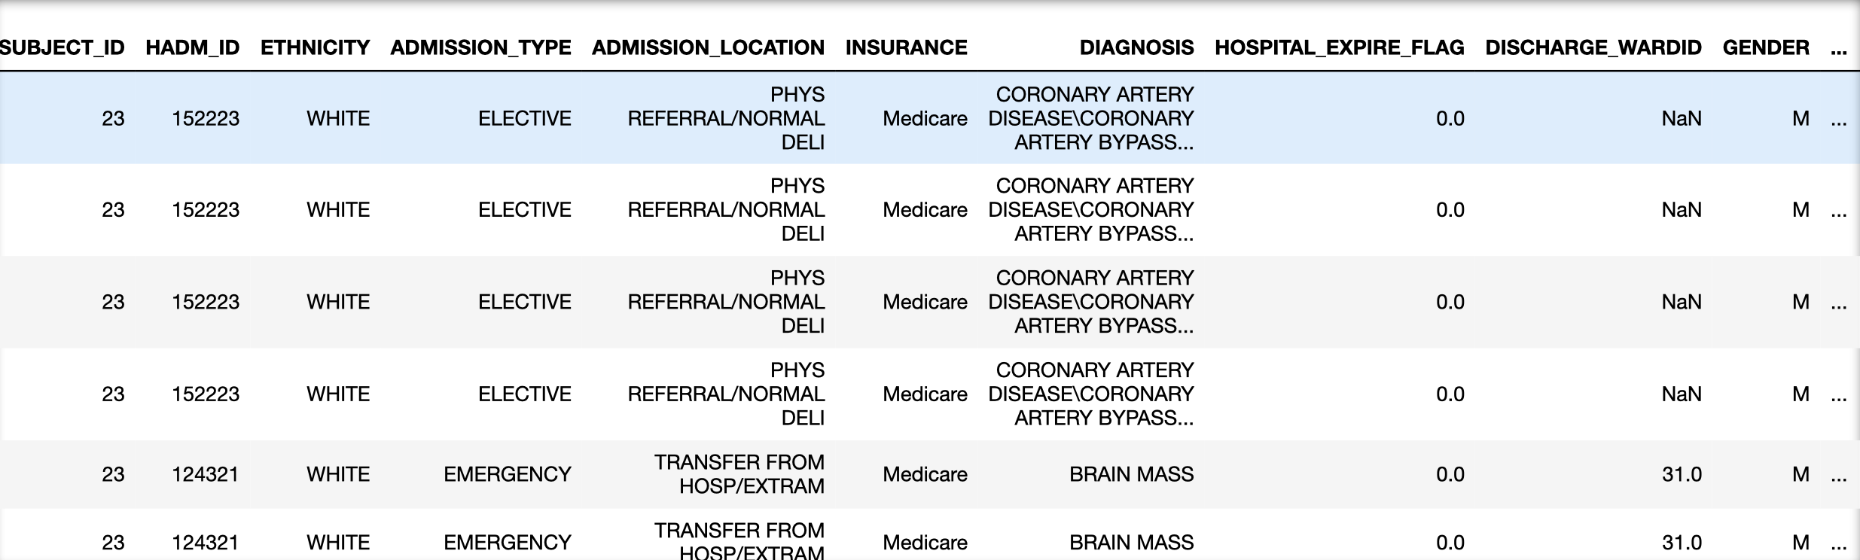
Last week:
In the process of preparing dataset,
Gathered good number of columns but few were left.
Faced few issues during merging.

Slide 3
Current status:
Did few changes in merge.
Remaining columns(Age, num_emergency, num_inpatient, Readmit and few drugs) are added to the dataset.
Implemented few data cleaning techniques such as.
Remove columns that have more null values
Remove Non-Standard Missing Values (UNKNOWN/NOT SPECIFIED or UNABLE TO OBTAIN in ETHNICITY)
Replace null values with appropriate value(median)
Set uniquely valued identifying field of the data as its index.(HADM_ID in our dataset)

Slide 4
Sample code for calculating readmit column

Slide 5
Mortatlity Count

Slide 6
Final Dataset

Slide 7
Next Step
Data Cleaning if left, according to feedback
As per prof guidance.

